Slide 1
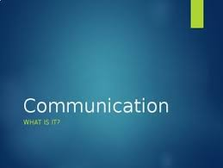
Introduction to Communication Unit – 1 English – 18LEH101J

Slide 2
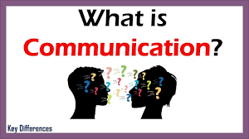

Contents
Definition – What is communication?
Types of communication
Process of communication
Channels of Communication
Barriers of communication
How to overcome the barriers
LSRW Skills

Slide 3
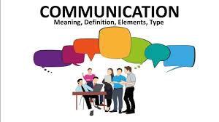
Communication
Communication is the transmission of information, ideas, emotions, skills, etc., by the use of symbols, words, pictures, figures, graphs, and other means.
It is the act or process of transmission that is usually called communication.
It is commonly defined as “the imparting or interchange of thoughts, opinions or information by speech, writing, or signs”

Slide 4
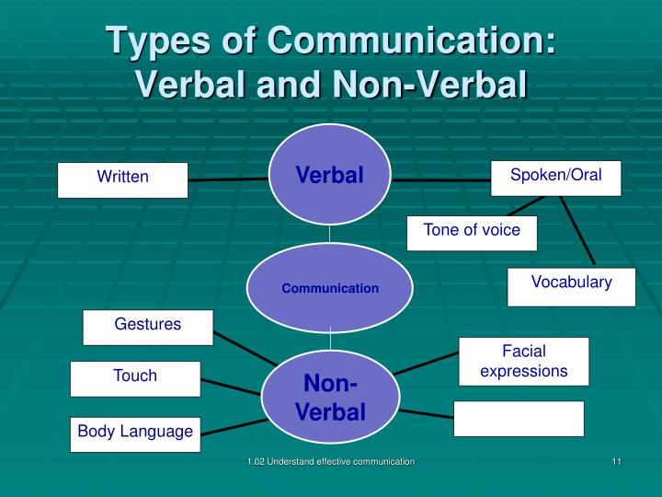

Slide 5
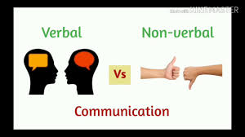
Types of Communication
1. Verbal communication
2. Nonverbal communication
Verbal communication
A Dialogue is a reciprocal conversation between two or more entities under which the oral and written communication take place.
It refers to the communication in which the message is transmitted verbally
Nonverbal communication

Slide 6
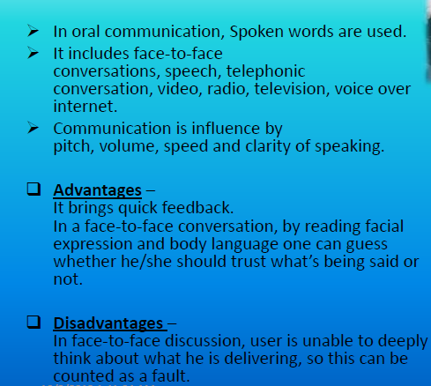
Verbal Communication

Slide 7
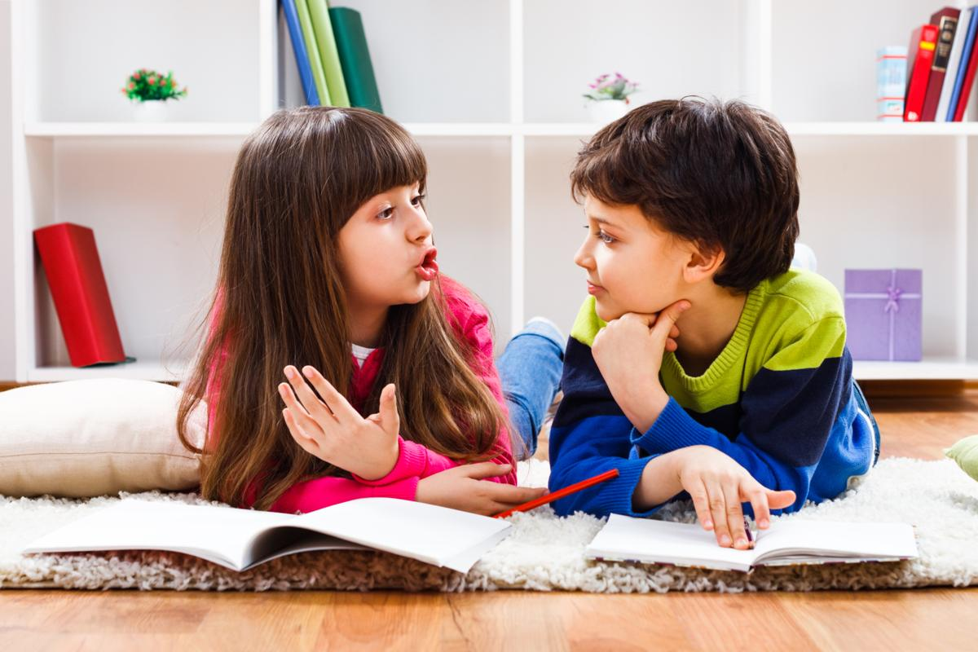

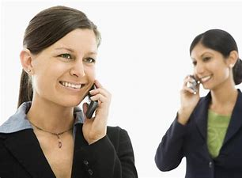
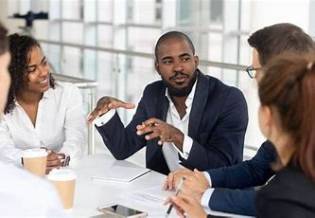

Slide 8
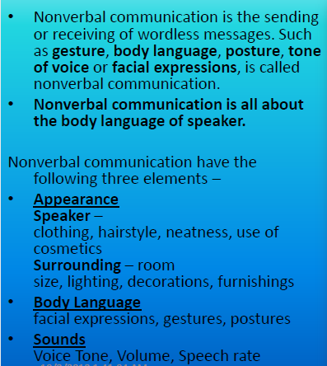
Non–verbal Communication

Slide 9

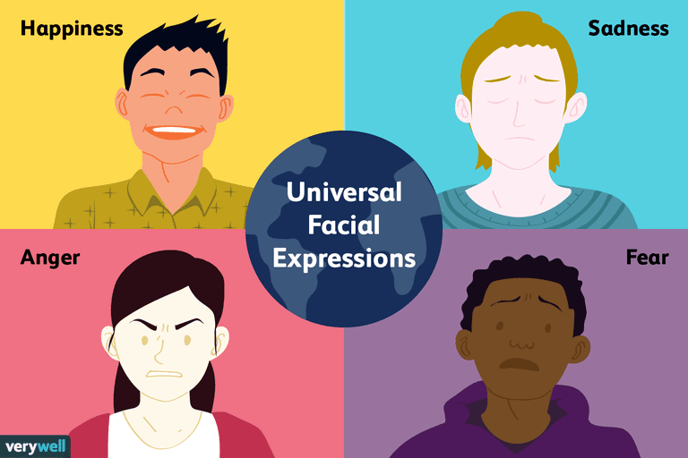

Slide 10
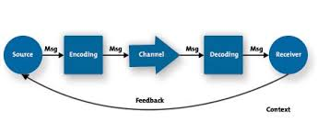
Process of Communication
The Process of communication involves ideation, encoding ,channelizing, decoding and feedback.

Slide 11
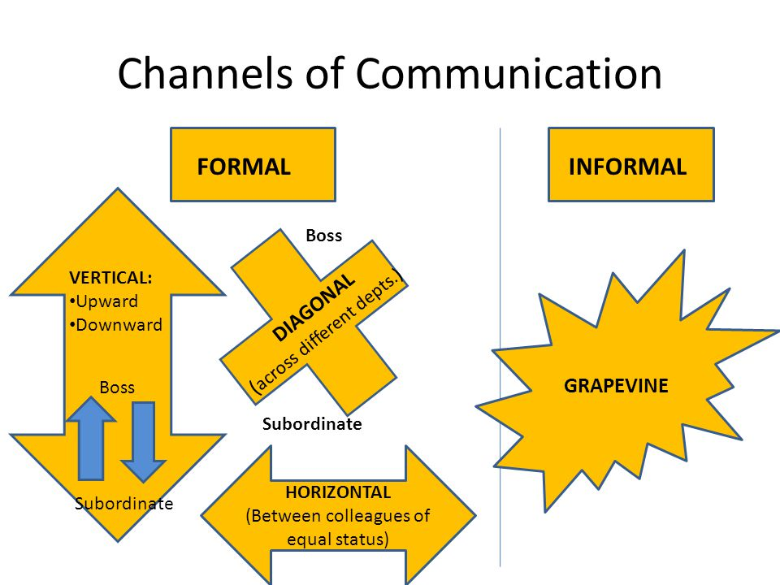
CHANNELS OF COMMUNICATION
In any work place all forms of communication are routed through different types of channels to the nature and purpose of communication.
The following are the channels /directions of communication used in workplaces.
Upward Communication
Downward Communication
Horizontal Communication
Diagonal Communication

Slide 12
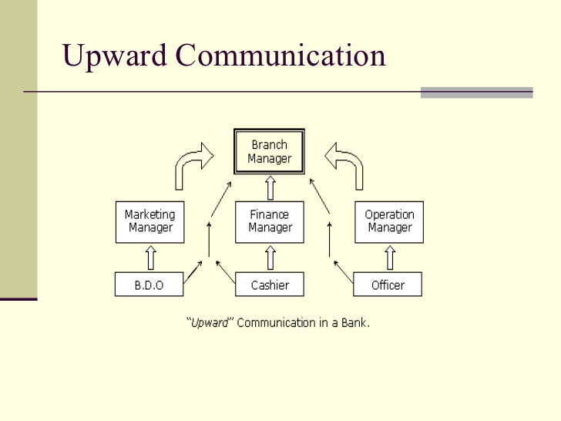
Upward Communication
Upward communication starts from the lower levels and goes up to the higher level.

Slide 13
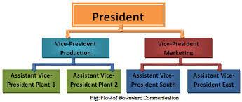
Downward Communication
Downward communication follows the hierarchical order from the higher to the lower level.

Slide 14
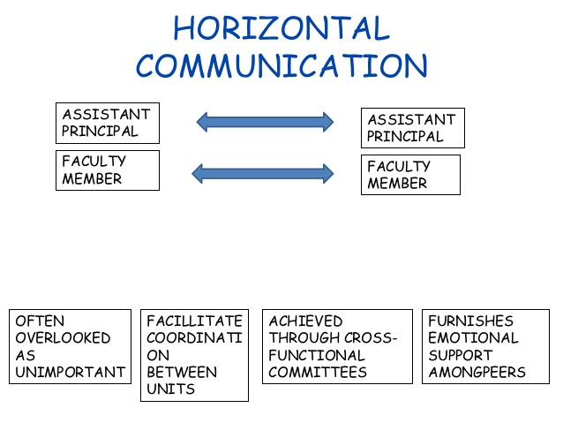
Horizontal Communication
Horizontal Communication takes place between employees of equal ranks and sometimes among the peer groups.

Slide 15
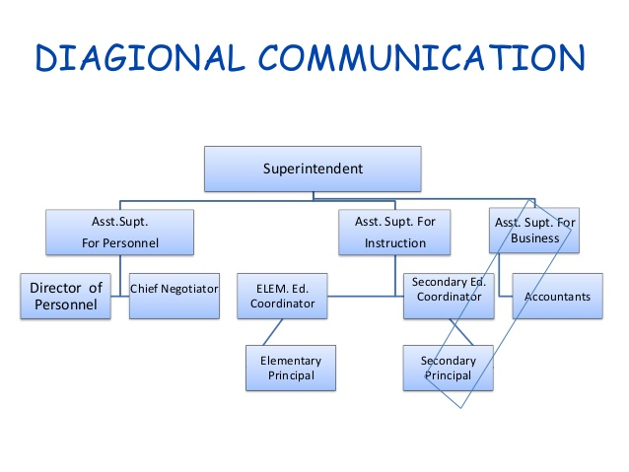
Diagonal Communication
Diagonal Communication happens across all official cadres and no hierarchy is followed. This is also known as Grapevine communication.
This is a mode of informal, unofficial but effective way of communication.

Slide 16
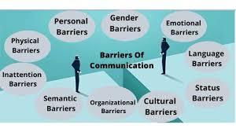
Barriers of Communication
Communication is snot always successful and there are a few factors that barrier communication.
Anything which acts as a threat or hinders communication is a communication barrier.
Language Barrier
Personal Barrier
Organisational Barrier

Slide 17
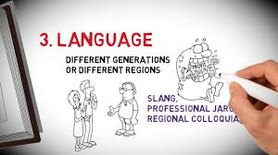
Language Barrier
Improper Message
Confusion resulting from homophones and spelling
Wrong translation
Bombastic or ostentatious language
Incorrect accent

Slide 18
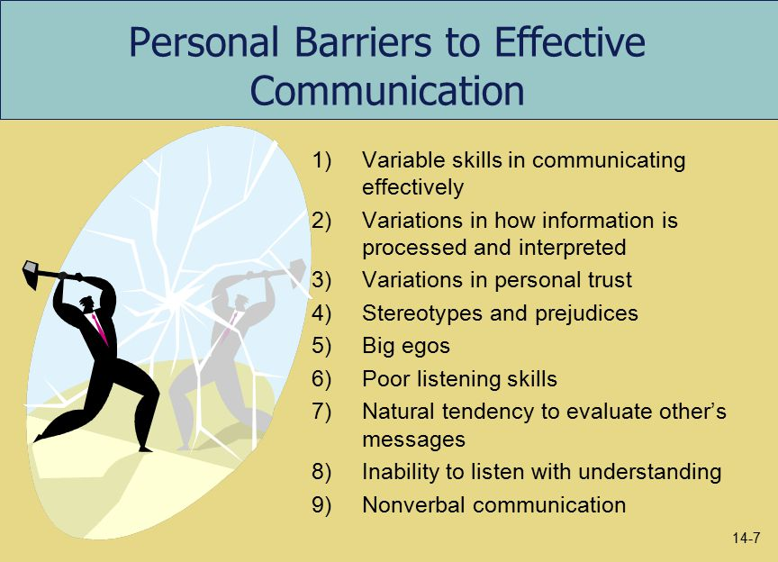
Personal Barrier
Improper time management
Physical Inconvenience
Passive Listening
Individual perception
Lack of Concentration
Assumptions
Fear of Superiors

Slide 19
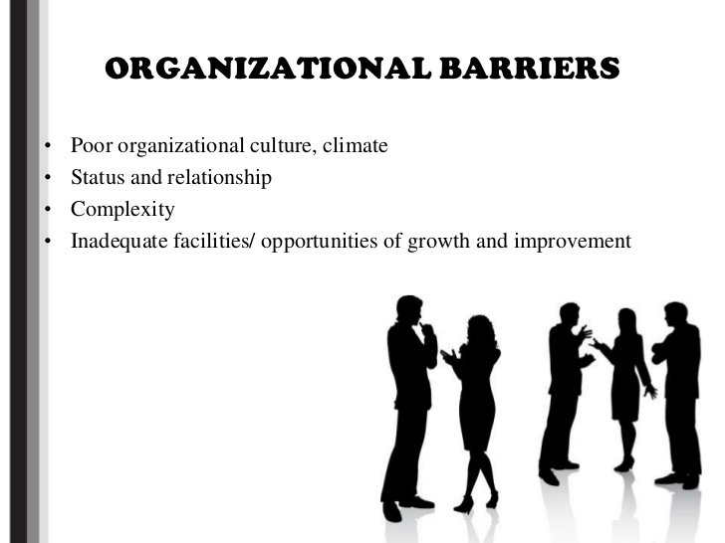
Organisational Barriers
Strict Boss
Status Problem/ego
One way communication
Rigid rules
Job Pressure
Poor working environment

Slide 20
How to overcome these Barriers?
Be clear and precise
Let the sentences be short and simple with easy words
Speak at a normal place
Improve concentration and active listening skills
Plan your schedule and act accordingly
Avoid being egoistic and give way for suggestions
Know your audience
Appreciate feedback

Slide 21
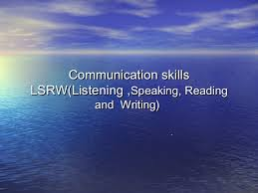
LSRW
Language is never learnt. It is acquired.
To acquire a language one should follow a natural way of learning things.
LSRW (L-Listening, S- Speaking, R- Reading, W-Writing) is the natural way of acquiring language.

Slide 22
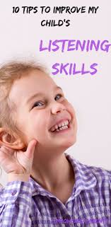
Listening
45% of our communication is listening, it is the
most difficult one to practice.
Difference between Listening and Hearing
Listening is an active process wherein we concentrate
and retain the information listened.
Hearing is a passive process wherein the listener
does not want to retain any information.
Barriers to listening are external noise, personal distraction inappropriate place and time, information overload and selective listening.
To avoid listening barriers one can practice active listening, involves uninterrupted listening, concentration, asking questions and observing the non-verbal cues and the ability to restate the messages.

Slide 23
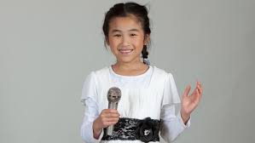
Speaking
To be an effective speaker one should follow the following rules:
Use appropriate vocabulary.
Use words in correct order.
Check the stress, rhythm and
intonation accordingly.
Use simple language and avoid ostentation.
Avoid hanging thought, relate whatever you say.
Know your listener / audience.
Avoid slang and un-parliamentary words.
Synchronize the body language and words.
Be slow, if you doubt your pronunciation.

Slide 24
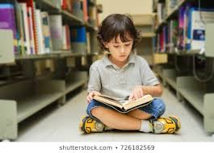
Reading Types of Reading
It is the process of decoding the symbols
on the page (print or electronic) for a
meaningful comprehension
Reading is of four types :
Skimming
It is to gather the most important information by running the eye over the text.
One tends to read the title, sub titles and topic sentences. Skimmers will not look for minute details.
Pictures, graphs and charts help in additional understanding of the text.
Scanning
It is to find a particular piece of information.
The scanner scans the text until he finds what he was looking for.

Slide 25
Types of Reading
Reading for thorough comprehension
It is when the reader wants to gain the full knowledge or information in the text.
The reader tries to understand the relationship between the ideas of the text including the author’s purpose.
Vocabulary enhancement takes place unknowingly.
Critical reading
Critical reading takes place when the reader tends to make judgment on the piece of work.
The reader comes up with various questions and arguments.
It is done to understand the author’s purpose of writing the text and language used.

Slide 26
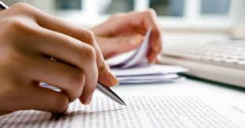
Writing
Writing is when we put our thoughts in words on a paper or computer screen
It is considered to be the most difficult skill and therefore is less preferred
It is usually more formal and therefore the writers have to be more careful about the grammatical rules, syntax and lexical items
If the writing is comprehensible and creative then the writer has achieved the purpose
One should use proper punctuation
so that the reader can arrive at what
the author is trying to convey.

Slide 27

Thank You

